Slide 1
Domestic Electricity Bill Monitoring

Slide 2
Introduction

Slide 3
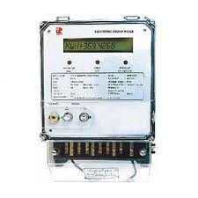
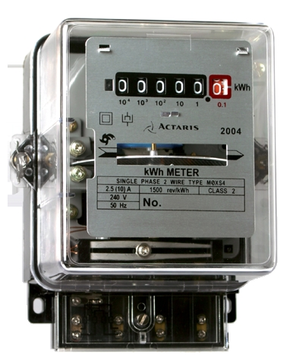
Present day meters
Analog Meter
Digital Meter

Slide 4
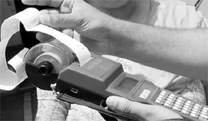
Present Day Bill Generator

Slide 5
Problems faced by common people due to electricity
It has become a common sight that angry citizens take to the streets in protesting against the terrified power situation. Some of the areas receive only an hour of electricity every day.

Slide 6
Distribution Problems
The peak power deficit-the gap between demand and supply in the summer of 2012-according to the Government's own calculations was 10.8 per cent.
The responsibility for distributing available power inefficiently falls on the states. Losses in distribution average over 30 per cent across India.(Due to both Illegal Usage and Transmission Losses.)

Slide 7
Usage Stats
S.No. | Sector | Consumption (Billion KWh) | Saving Potential (Billion KWh)
1. | Agriculture Pumping | 92.33 | 27.79
2. | Commercial Buildings/ Establishments with connected load > 500 KW | 9.92 | 1.98
3. | Municipalities | 12.45 | 2.88
4. | Domestic | 120.92 | 24.16
5. | Industry (Including SMEs*) | 265.38 | 18.57
 | Total | 501.00 | 75.36
*SME=Small and Medium Enterprises

Slide 8
Cost of Electricity
Taking the case of state of Gujarat ( For the basis of calculation to apply for all India for analysis purpose) based on the approved ARR, the average cost of supply for FY 2009-10 works out to Rs. 4.17/kWh (Rs 17,791 cr/ 42,661 MUs).

Slide 9
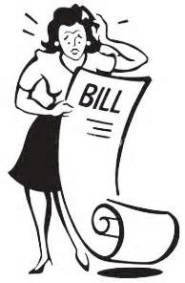
Human Reaction

Slide 10
Wastage of power due to unmetered connections
In most of the states, agricultural consumption is un-metered
About 50% of Indian populations are farmers.
About 20% of the farmers have electric pumps. Hence, only 10% of population directly benefit from agricultural electricity use.
Lack of perennial rivers made ground water tapping a prerequisite in irrigation in south India.

Slide 11
Wastage of power due to unmetered connections(Contd…)
This has led to an increase in consumption of electricity by agricultural sector.
73% of Indian population depends directly or indirectly on agriculture..
Consumers pay a flat rate tariff which is also highly subsidized.
As a result there is further wastage of electricity by using sub standard pump sets

Slide 12
Present Day Payment Method

Slide 13
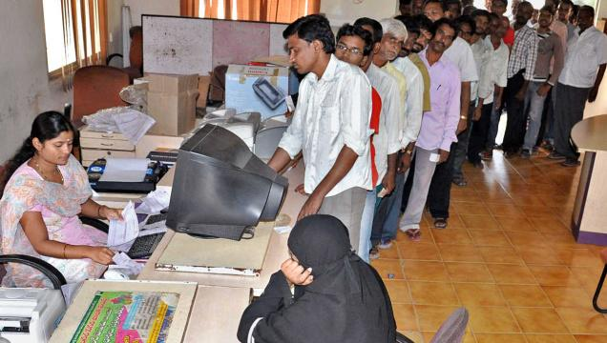
Long Queues

Slide 14
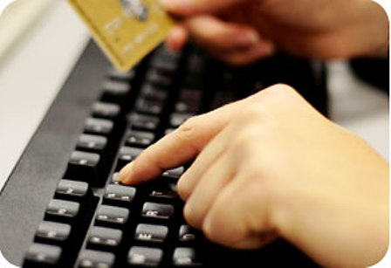
Online Payment

Slide 15
Malpractices

Slide 16
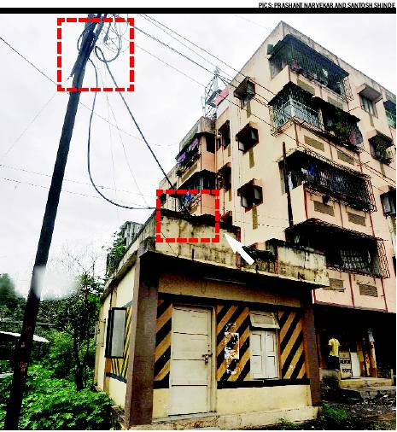
Illegal Connections

Slide 17
Survey Responses

Slide 18
Place of Living

Slide 19
Electricity Connection

Slide 20
Meter Type

Slide 21
Power cuts in India( from Survey)

Slide 22
Information about Power cuts

Slide 23
Information about Changes in Charges/unit

Slide 24
Delay in Bill Generating/Issuing

Slide 25
Delays during Repairs

Slide 26
Time taken for Response from Electricity department

Slide 27
Saving electricity through daily updates

Slide 28
Payment Method…..!

Slide 29
Long Queues at the time of Bill Payment

Slide 30
Bill Amount…...!

Slide 31
Switching off the Mains

Slide 32
Need for a Change in Present day System

Slide 33
Conclusions

Slide 34
Conclusions
According to the survey majority of the people have an electricity connection with digital meters.
As per our survey many villages are affected by power cuts without prior notice which makes it difficult for farmers.
Charges/units of electricity are increased very often but very few people keep track of this information.

Slide 35
Conclusions(Cont.…..)
In Villages there are many delays in issuing bill, which makes it difficult for people to pay the bill in time.
Most of the people pay their bill in cash for which they have to wait in long queues.
As per our survey most of the people agreed that they can save electricity if they get daily updates of power consumption.

Slide 36
Conclusions(Cont.….)
According to the survey many people want the system of electricity billing and customer service to be changed.
So, We would like to develop a SYSTEM which mostly overcomes the above problems.

Slide 37
CAD Models

Slide 38
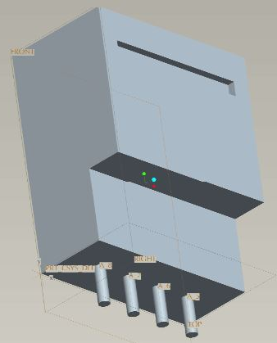
Meter with System Inbuilt

Slide 39
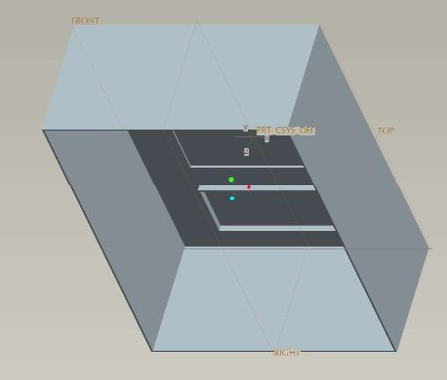
Box

Slide 40
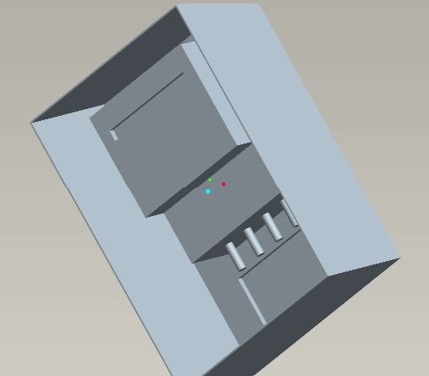
Meter in Box

Slide 41
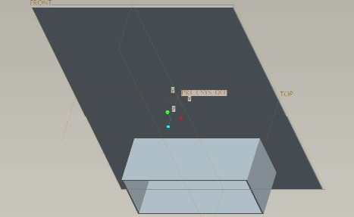
Lid

Slide 42
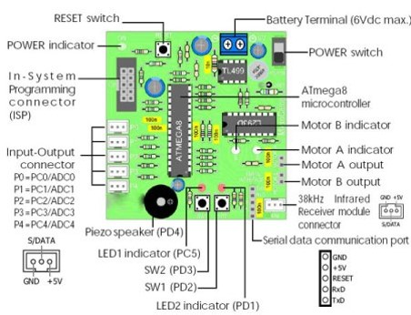
Type of PCB used

Slide 43
Process Flow

Slide 44
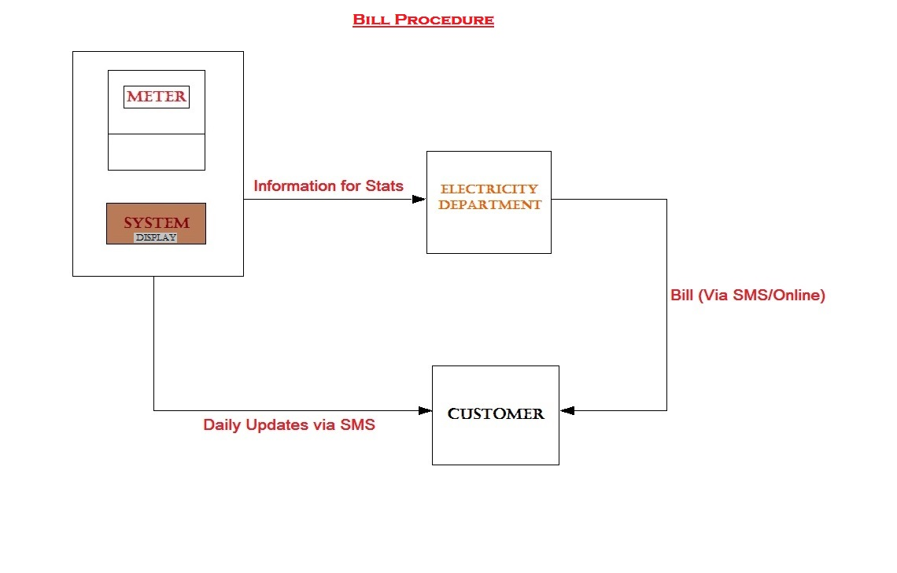
Billing Procedure

Slide 45
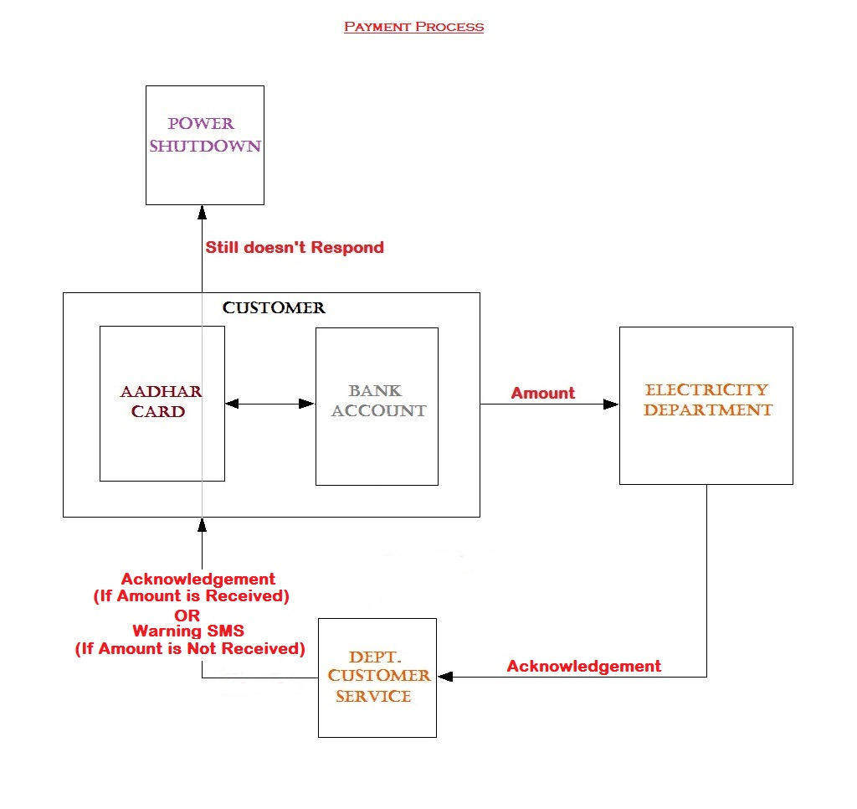
Bill Payment

Slide 46
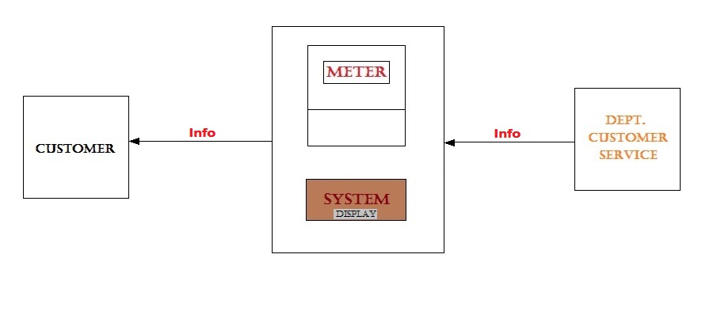
Power cut Info

Slide 47
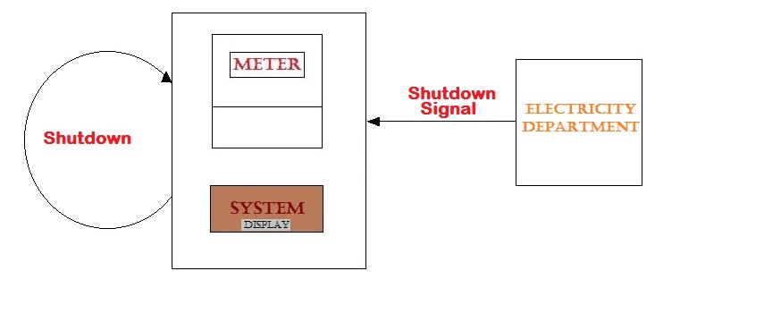
Auto Disconnecting Feature

Slide 48
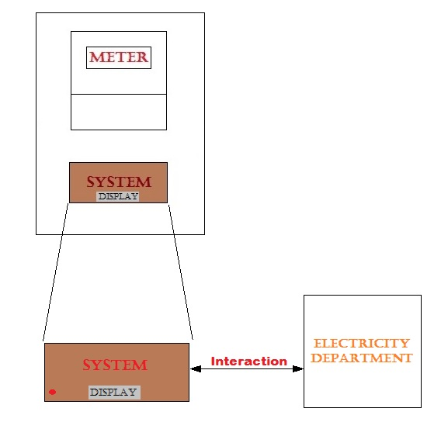
Error Detection

Slide 49
Possible Solutions

Slide 50
Possible Solutions
ZIG-BEE Based System
GSM based System
Cloud based System
Optional
Mobile apps (Android/ iOS / Windows phone)
Web based solution

Slide 51
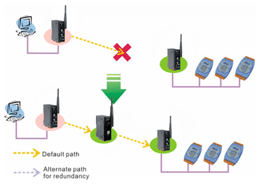
Zig-Bee Based System
This type of technique is used for wireless transmission of data over a long range through Repeaters

Slide 52
Cloud Based System
The System is connected to the internet through Wi-Fi or LAN
There will be a database for the customers in the electricity department
Any alerts will be pushed from the database to the customers mobile through the system

Slide 53
GSM Based System
There will be a SIM Card inserted in the system to communicate with the department
System collects the information from the meter and sends the data to both customer and electricity department
Customer receives daily alerts directly from the system

Slide 54
Mobile Apps
There is an optional advantage available for smartphone users
Apps can be designed for platforms like Android/ iOS /Windows Phone to get daily alerts and also avail banking facilities for bill payment
A login id and password will be created for this purpose
Messages will be pushed through the respective platforms’ servers, no extra server space needed

Slide 55
Web based Solution
For non smartphone users there is also a web based solution where users can view the daily updates as well as pay the bill online
A login id and password will be created for this purpose

Slide 56
Thank You…….!

